Slide 1
AP World History: Modern
Unit 3: Land-Based Empires
1450-1750

Slide 2
Sub-Units
3.1 - Empires Expand
3.2 - Empires: Administration
3.3 - Empires: Belief Systems

Slide 3
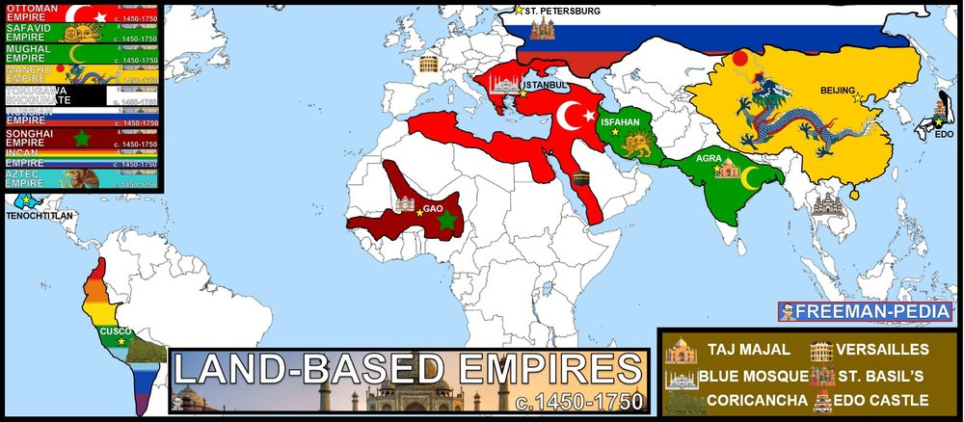

Slide 4
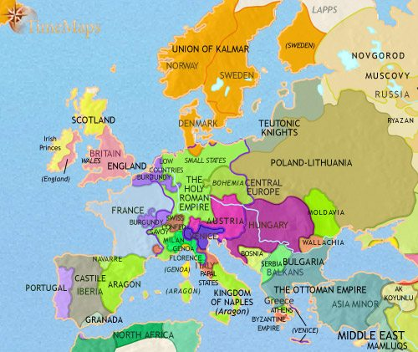
Modern Europe Takes Shape

Slide 5
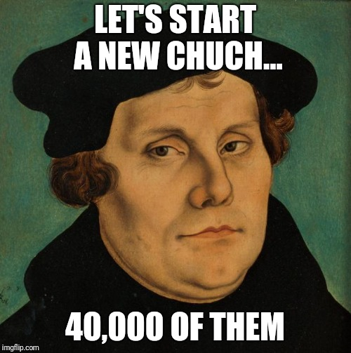
Protestant
Reformation

Slide 6
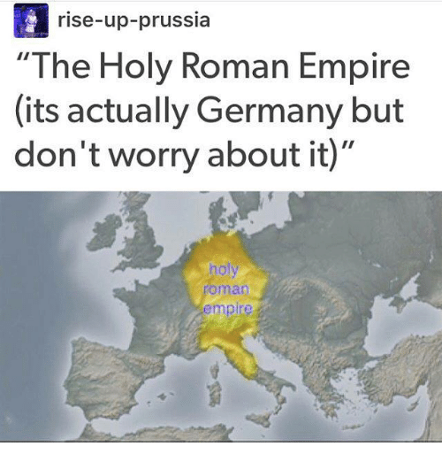
Europe’s Medieval Period
Few kingdoms.
Feudalism
Local lords
Catholic church controls these lords
Holy Roman Empire

Slide 7
Church Power
Competed with Italian princes for political power
Hoarded money to build churches
Fought in wars
Plotted against powerful monarchs
  Philip IV of France arrested Pope Boniface XVIII in 1302
Sold Indulgences
  You pay the Pope money, he gives you a piece of paper that got you out of purgatory quicker. Hooray!

Slide 8
Early Reformers
Due to harsh life and bubonic plague, people began to question the church.
  Humanist ideas spurred by the Renaissance made this possible.
Erasmus is one of the first reformers.
  Dutch Catholic priest
  Remained Catholic his whole life, but wanted to “fix” the church and return it to its simpler, less worldly ways.
  Stressed bible study
    Why was bible study so difficult for the average person?

Slide 9
Martin Luther
Lived from 1483-1546 in Germany
Father encouraged him to study law
A sudden religious experience inspired him to become a monk
He became troubled over the possibility of not going to heaven
He turned to the Bible and confession for comfort
In the Bible he found the answer he was looking for

Slide 10
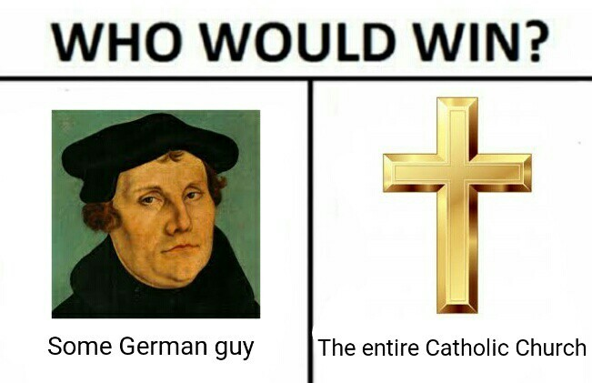
Romans 1:17
“The righteous shall by his faith.”
Luther realized that only faith (in the ultimate goodness of Jesus), not good deeds, could save a person. No good works, rituals, etc. would save a person if they did not believe.

Slide 11
The 95 Theses
Luther created his 95 theses, or complaints against the Catholic church
He criticized:
  The Power of the Pope
  The Extreme Wealth of the Church
  Indulgences
He used Gutenburg’s printing press to print multiple copies
Hung them on church doors on October 31, 1517
Passed them out to people on the streets
  Church was unhappy, but people liked it, so what could they do?

Slide 12
Luther On Trial
The Diet of Worms
1520 Pope Leo X ordered Luther to give up his beliefs
Luther burned the order and was excommunicated
Luther went into hiding where he translated the New Testament into German – spreading his beliefs even further

Slide 13
Protestantism Is Born
Some Local German Churches accepted Luther’s ideas
Lutheranism was formed
Supported by German Princes who issued a formal “protest” against the Church for suppressing the reforms
The reformers came to be known as [PROTEST]ants - Protestants

Slide 14

John Calvin
Swiss reformer
Influenced by Luther
  Disagreed with his “salvation through faith alone” mantra.
Believed in predestination
  God knew everything that will happen
“Purified” approach to life:
  No drinking
  No swearing
  No gambling
  No card playing

Slide 15
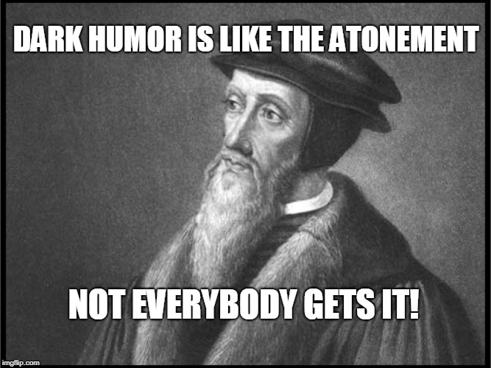
Calvinism Spin-offs
England = Puritans
Scotland = Presbyterians
Holland = Dutch Reform
France = Huguenots
Germany = Reform Church
Anabaptists
  Believed in separation of church and state and did not believe in infant baptism
Lutherans and Catholics both despised Calvinists.

Slide 16
Religious Wars Begin
Germany – Catholics and Lutherans opposed Calvinists
France – Wars between Catholics and Calvinists
Netherlands – Calvinists are prosecuted
England – Some Calvinists fled to America for religious freedom
Scotland – Calvinist John Knox overthrew Catholic Queen

Slide 17
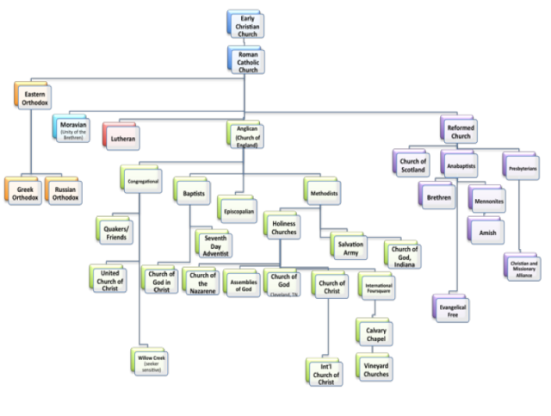

Slide 18
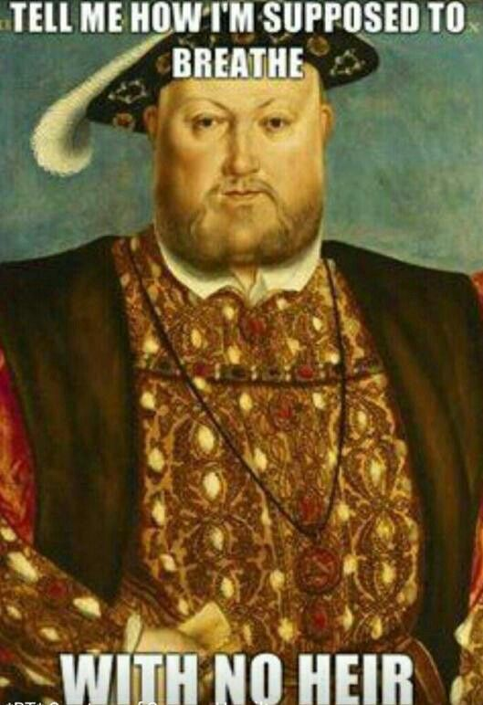
English Reformation
Henry VIII
  Wanted annulment from wife, Catherine.
Wanted to marry Anne Boleyn
  Hoping she could give him a son.
Catholic church refused
Henry took over the church
  Enacted many Protestant beliefs.
Thus begins the Church of England
  or Anglican Church (same religion)
Married Boleyn
  Gave him a daughter, Elizabeth

Slide 19
Absolutist
Monarchs

Slide 20
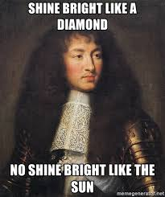
Louis XIV
Took power or France in 1643 at the age of 5 years old.
Cardinal Mazarin was chief minister.
Mazarin dies in 1661, and Louis took absolute power.
Took the sun as symbol of his absolute power.
  Known as “The Sun King”
“Just like sun sits in center of universe, so do I stand at center of nation.”
“L’etat, c’est moi” (I am the state)

Slide 21
How Powerful Was Louis XIV?
Expanded bureaucracy
Appointed intendants (royal officials who collected taxes)
Built strongest standing army in Europe (300,000 soldiers)
High-ranking nobles would compete for the privilege of:
  Waking Louis
  Putting Louis to bed
  Dressing Louis
  Feeding Louis
  Even giving Louis a bath!
  WHY?!?!?!?

Slide 22
Versailles
Moved royal palace from the modern day Louvre in central Paris to his dad’s old hunting grounds 12 miles outside of Paris.
Built it into the grandest building in Europe
  A show of wealth and power
  Adorned with gold
  Symbols of the sun everywhere
Forced the French nobles to live in the palace with him for part of the year
  Their families stayed home
Helped pay for Versailles by forcing these nobles to pay Louis rent

Slide 23
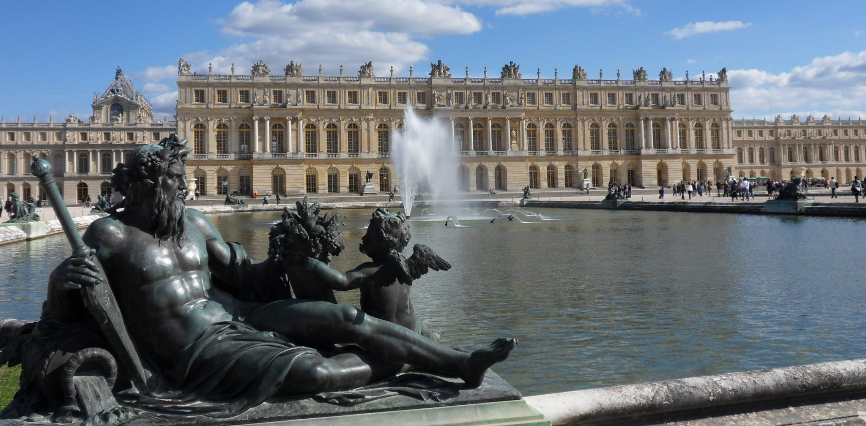
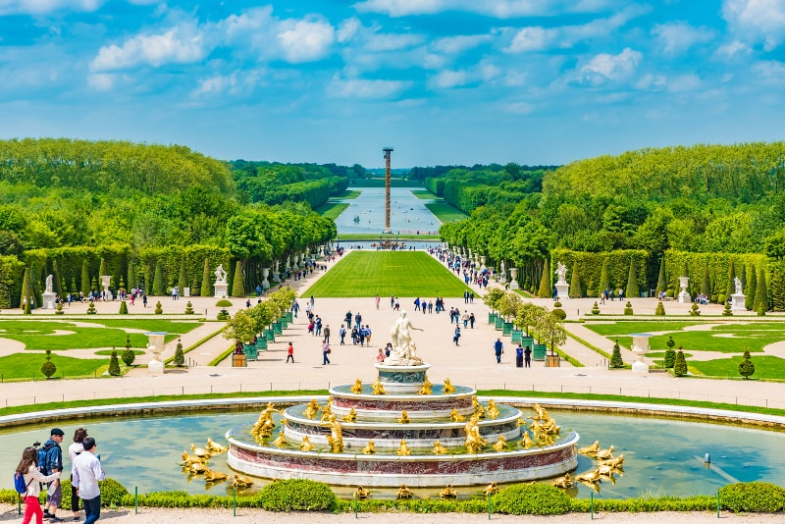
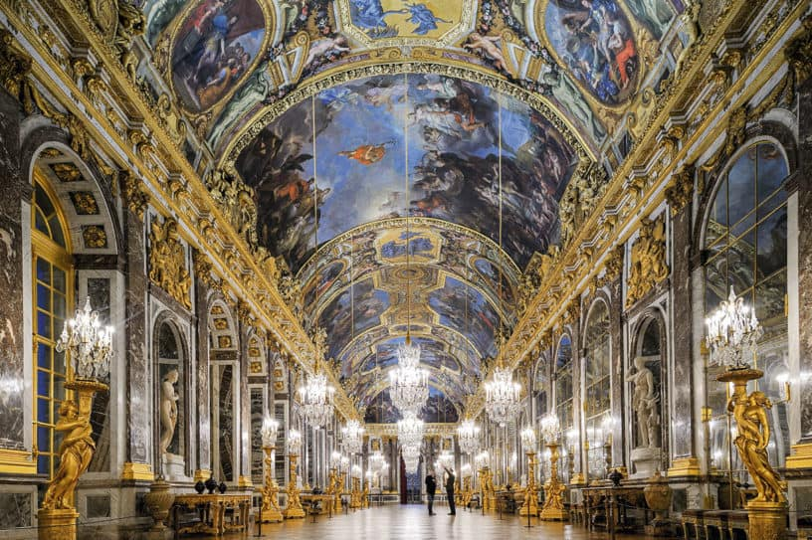
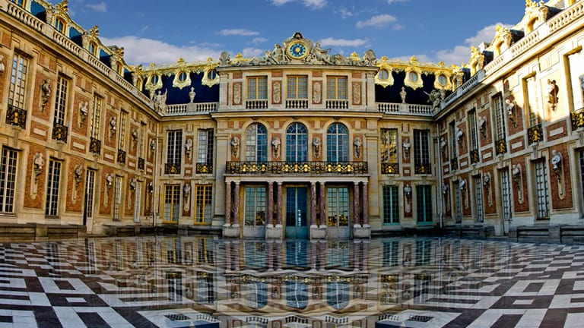

Slide 24
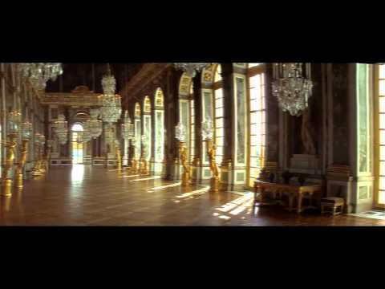
History of Versailles

Slide 25
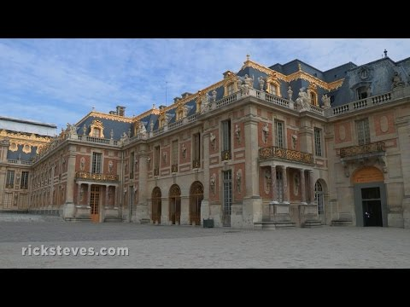
Tour of Versailles

Slide 26
Absolutism in Britain
1485-1603: Tudors (Henry VIII, Elizabeth I) worked closely with British Parliament.
Elizabeth died childless in 1603.
James Stuart, King of Scotland, became King of England.
  Immediately clashed with Parliament.
Wanted to separate from Church of England and go back to Catholicism.
Puritans sought to “purify” the church of Catholic practices.

Slide 27
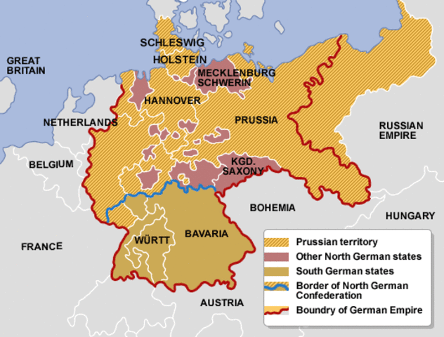
Absolutism in Central Europe

Slide 28
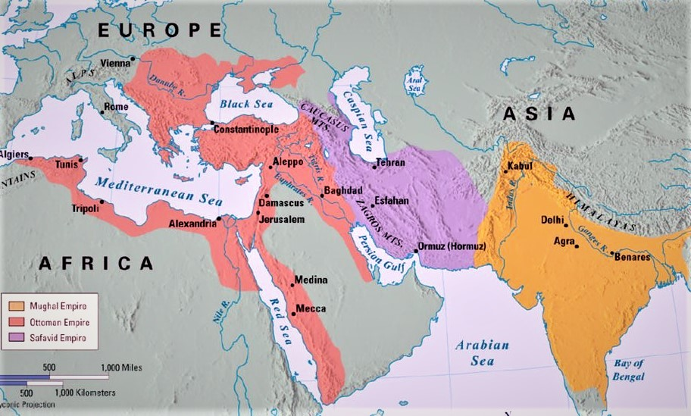
Gunpowder Empires

Slide 29
Comparisons
Self-defense extremely important
Ottoman, Safavid, Mughal, Russian, Manchu
Relatively large
Expensive
  Focused on agriculture and not industry
Many were located in arid & uninhabitable area
Involved in forced labor
Power was centralized
Collected taxes through tax farming system
Between 1500 and 1800 had the largest administrative and economic systems because they were more of a threat to each other

Slide 30
Comparisons
Nomadism decreases on the steppes
Urbanization moving in
Switch to gunpowder technology away from mounted warriors
Not left behind, but greater than Europe

Slide 31
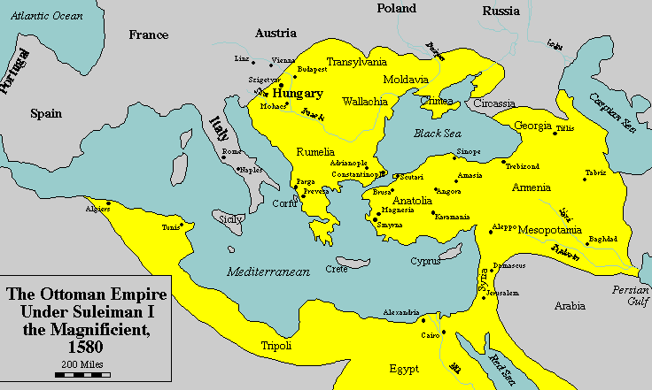
Ottoman Empire

Slide 32
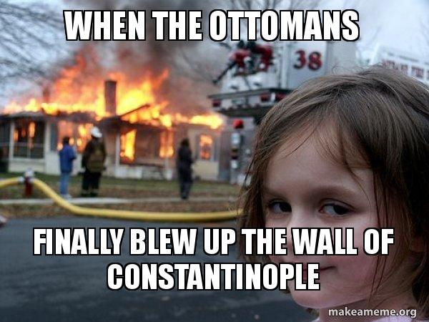
Ottoman Rise to Power
In 1299, Osman I took control of a small pastoral tribe of Turks south of Byzantine Empire.
He continuously raided the Byzantines, and though he kept losing, this also allowed him to get more people to join him.
In 1453, Mehmed II conquered Constantinople, ending the Byzantine Empire and setting the Ottomans as the foremost power in the Middle East.

Slide 33
Ottoman: Social
Patriarchial Society, but women had more rights than in many European societies of that time.
In Islam (and therefore, the Ottoman Empire), women could:
  Own land
  Obtain a divorce
  Testify in court
Women often controlled the household, and would often go out with neighboring women to the market, the park, etc.
If multiple wives, they would often stay in a harem.
  Harem: the separate part of a Muslim household reserved for wives, concubines, and female servants.
  Of course, not every household could afford this.

Slide 34
Ottoman: Political
Large bureaucracy
  a system of government in which most of the important decisions are made by state officials rather than by elected representatives
Expanded borders for protection
Used guns and gunpowder
Janissary
  Devshirme system
Ruled through locals in conquered lands
  Tribute system

Slide 35
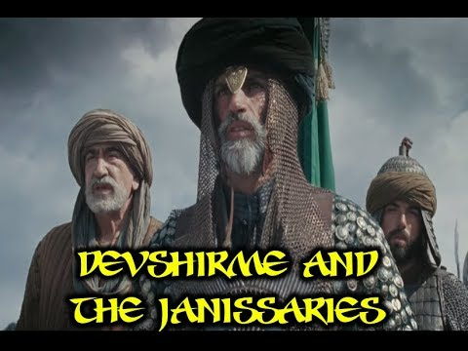
Devshirme System

Slide 36
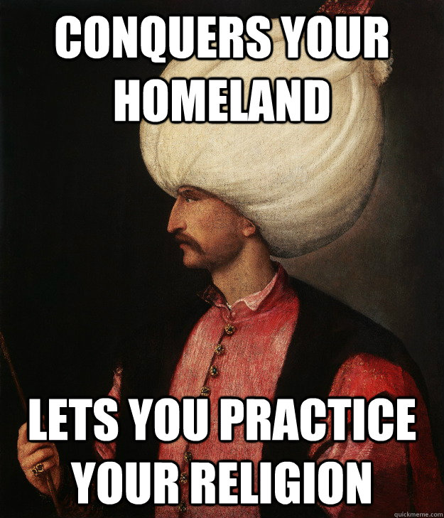
Suleiman the Magnificent
Ottoman Empire’s most powerful ruler.
1520-1566
Expanded borders to largest size
Created unified law code
  Including a law to stop the killing of Jews
Instituted freedom of religion
  Built churches and synagogues
  Continued to welcome the Jews from Spain in Spanish Inquisition
Jizya
  Tax on non-Muslims

Slide 37
Ottoman: Interactions
Religious Freedom
Millet
  Allowed separate religions to have their own laws and courts
  Had to recognize Suleiman and Ottoman law as grand law
  State vs. federal?
Very diverse population

Slide 38
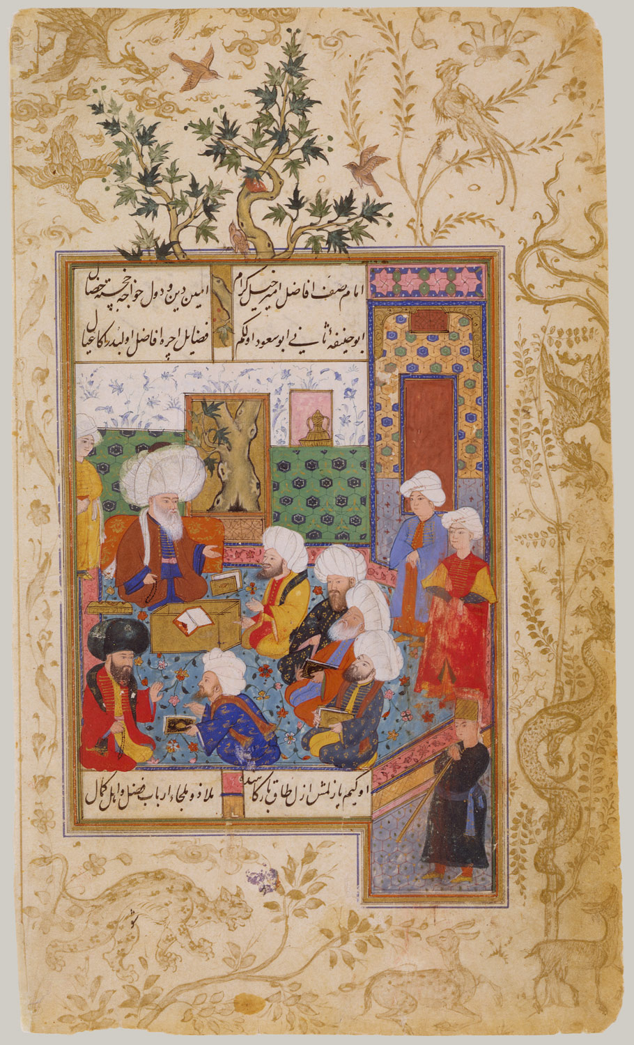
Ottoman: Cultural
Art and literature flourished, especially under Suleiman

Slide 39
Ottoman: Economic
Agricultural Society
Slow to adapt to innovations
  Eventually will be surpassed by Europe due to this

Slide 40
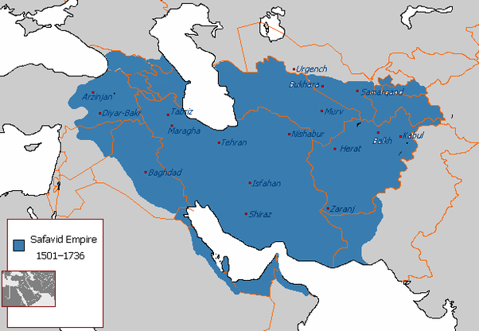
Safavid Empire

Slide 41
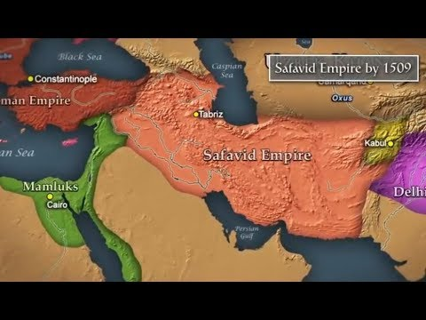
Safavid Empire

Slide 42
Safavid - Ottoman Wars
Main difference:
  Ottomans = Sunni Muslim
  Safavid - Shi’ite Muslim
Main conflict:
  The land on the eastern Mediterranean
In 1534, Ottoman’s took Baghdad
2nd War (1578-1590) gave Ottoman’s more Safavid land, including their capital city.
In 1602, Ottoman’s were distracted with wars against Habsburg’s in Europe.
  Safavid’s retook most of their land.

Slide 43
Safavid - Ottoman Wars
In 1624, Safavid’s retook Baghdad
  Huge blow to Ottoman ego
Safavid’s used this to take almost all of modern-day Iraq
In 1629, Ottoman’s found peace with Habsburgs
  Full attention now turned to Safavid’s
In 1638, Ottoman’s took Baghdad back
Treaty of Zahub signed on May 17, 1639
  Drew boundaries between empires
    Boundary line is today’s line between Iraq and Iran
  Made Ottoman’s the power in the region

Slide 44
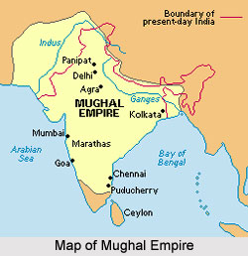
Mughal Dynasty

Slide 45
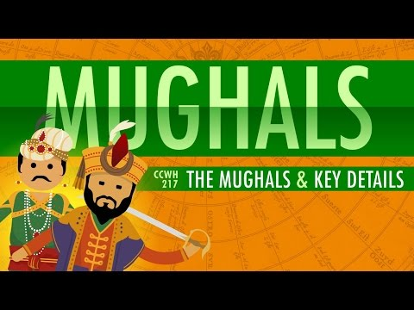
Crash Course: Mughals

Slide 46
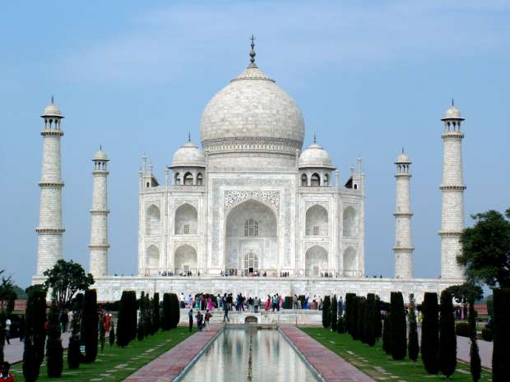
Taj Mahal
Commissioned in 1632 by emperor Shah Jahan
  Tomb for his favorite wife
Completely symmetrical
  EXCEPT for the tombs
  Did son do this on purpose to get back at dad?

Slide 47
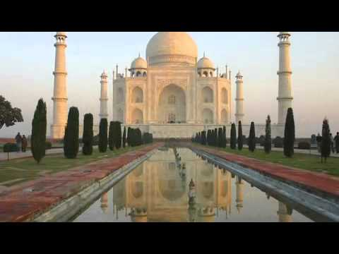
Taj Mahal

Slide 48
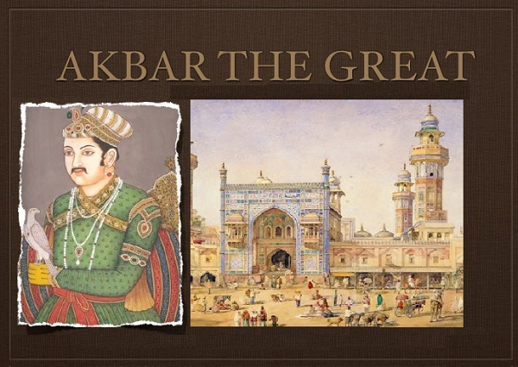
Akbar 1 (The Great)
Mughal emperor from 1556-1605
Spread borders to greatest extent
Religious freedom
  He was Muslim, but ruled over large Hindu population
  Would often have roundtable discussions on religion with Hindu’s, Christians, Jews, and other religions.
Encouraged scholars, painters, poets, and musicians to practice

Slide 49
Mughal - Safavid Wars
Three wars fighting over Kandahar region.
  Important area for trade
War of 1622-1623
  With Safavid - Ottoman war over for now, Safavid’s turn attention to Mughals
  War for control of Kandahar, in modern day Afghanistan
  Safavid victory
War of 1638
  Mughals retake Kandahar
War of 1649-1653
  Safavid’s retake Kandahar

